Slide 1


20.4 Combined Bayes-
Frequentist Estimation
May 29, 2018
PRESENTER : JongYun Kim
UNIST Autonomous System LAB
Address. 112-#810, 50 UNIST-gil, Ulju-gun, Ulsan, 44919, South Korea
Tel. +82 52 217 2368 Web. https://sites.google.com/site/aslunist/

Slide 2
Introduction
Bayesian estimates
In high dimensions
Immune from selection bias
A data-based model selection rule has no effect on the likelihood function or posterior distribution
…
To set proper prior becomes difficult and possibly dangerous in higher dimensions
A chosen prior has to apply to the entire parameters and not just the part we are interested in
Introduction to a Bayes-frequentist estimation technique like Tweedie’s rule in Empirical Bayes methods

Slide 3




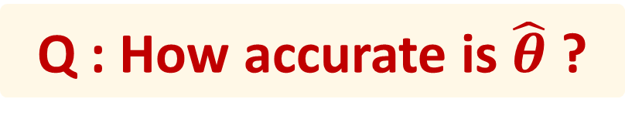
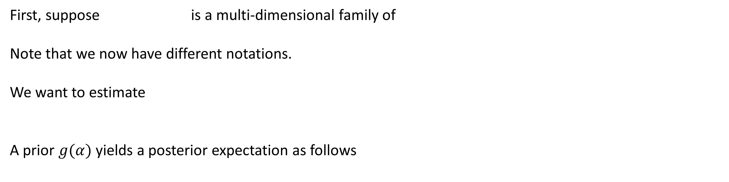
Problem Definition
First, suppose is a multi-dimensional family of
Note that we now have different notations.
We want to estimate
A prior $g(α)$ yields a posterior expectation as follows
Q : How accurate is $\hat{θ}$ ?
If we believe the prior, the posterior distribution has the exact answer.
But, the prior reflects mathematical convenience and a desire to be uninformative in most cases of high Dim.
There’s a danger of circular reasoning in using a self-selected prior distribution to compute the accuracy of its own estimator

Slide 4

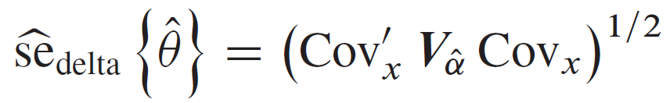

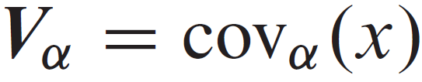

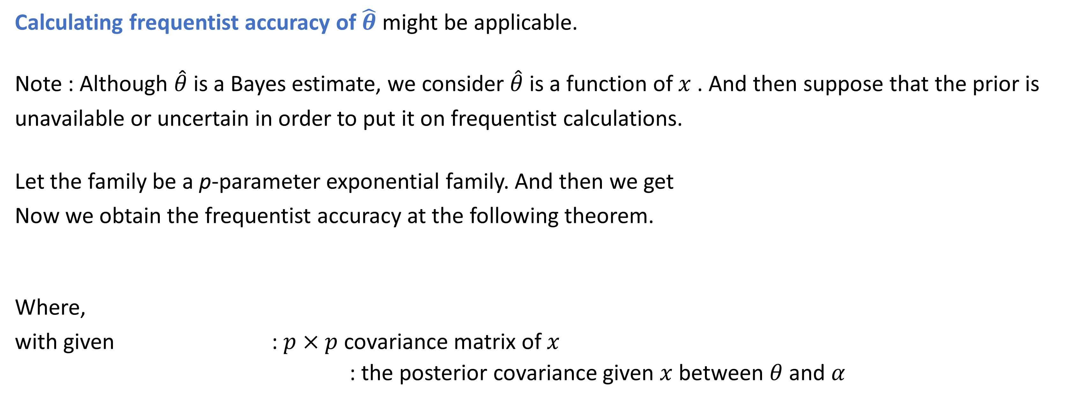
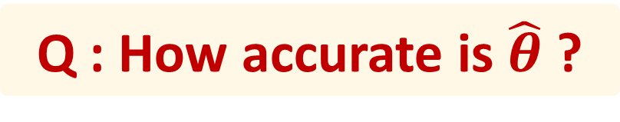
An Alternative Way : Frequentist Accuracy
Q : How accurate is $\hat{θ}$ ?
Calculating frequentist accuracy of $\hat{θ}$ might be applicable.
Note : Although $\hat{θ}$ is a Bayes estimate, we consider $\hat{θ}$ is a function of $x$ . And then suppose that the prior is unavailable or uncertain in order to put it on frequentist calculations.
Let the family be a p-parameter exponential family. And then we get
Now we obtain the frequentist accuracy at the following theorem.
Where,
with given : $p×p$ covariance matrix of $x$
: the posterior covariance given $x$ between $θ$ and $α$

Slide 5

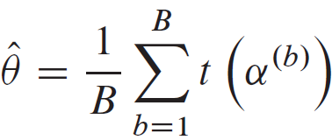
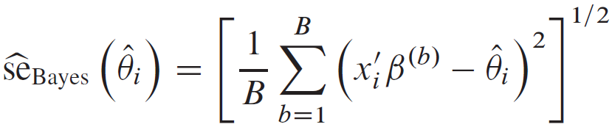

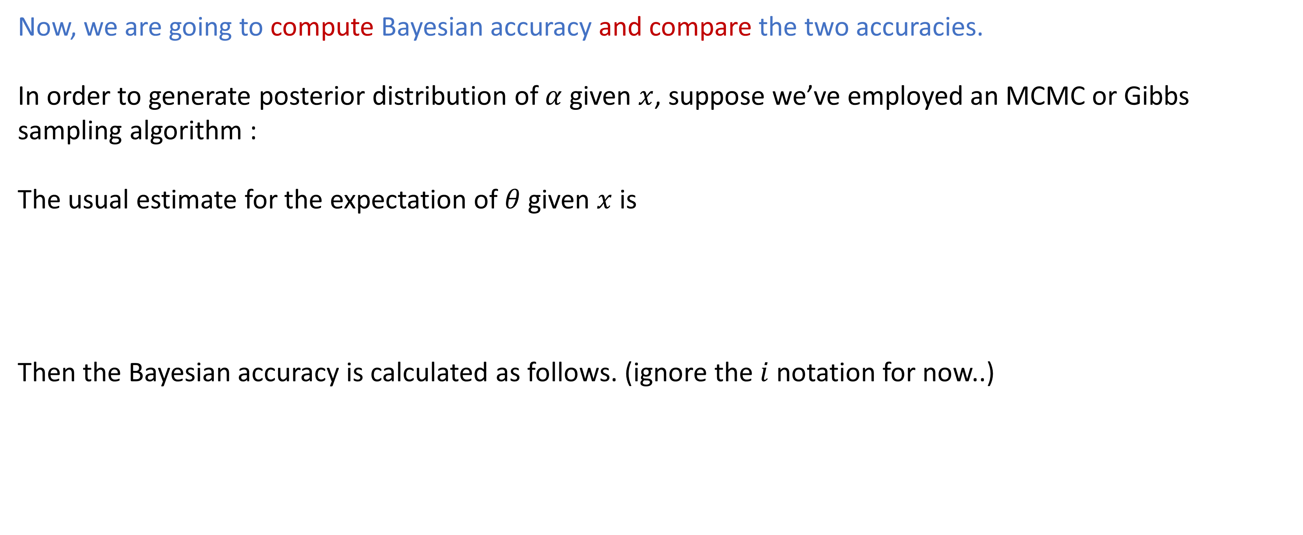
Bayesian Accuracy
Now, we are going to compute Bayesian accuracy and compare the two accuracies.
In order to generate posterior distribution of $α$ given $x$, suppose we’ve employed an MCMC or Gibbs sampling algorithm :
The usual estimate for the expectation of $θ$ given $x$ is
Then the Bayesian accuracy is calculated as follows. (ignore the $i$ notation for now..)

Slide 6



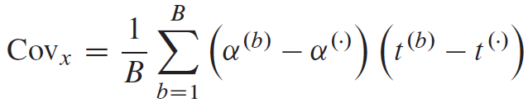
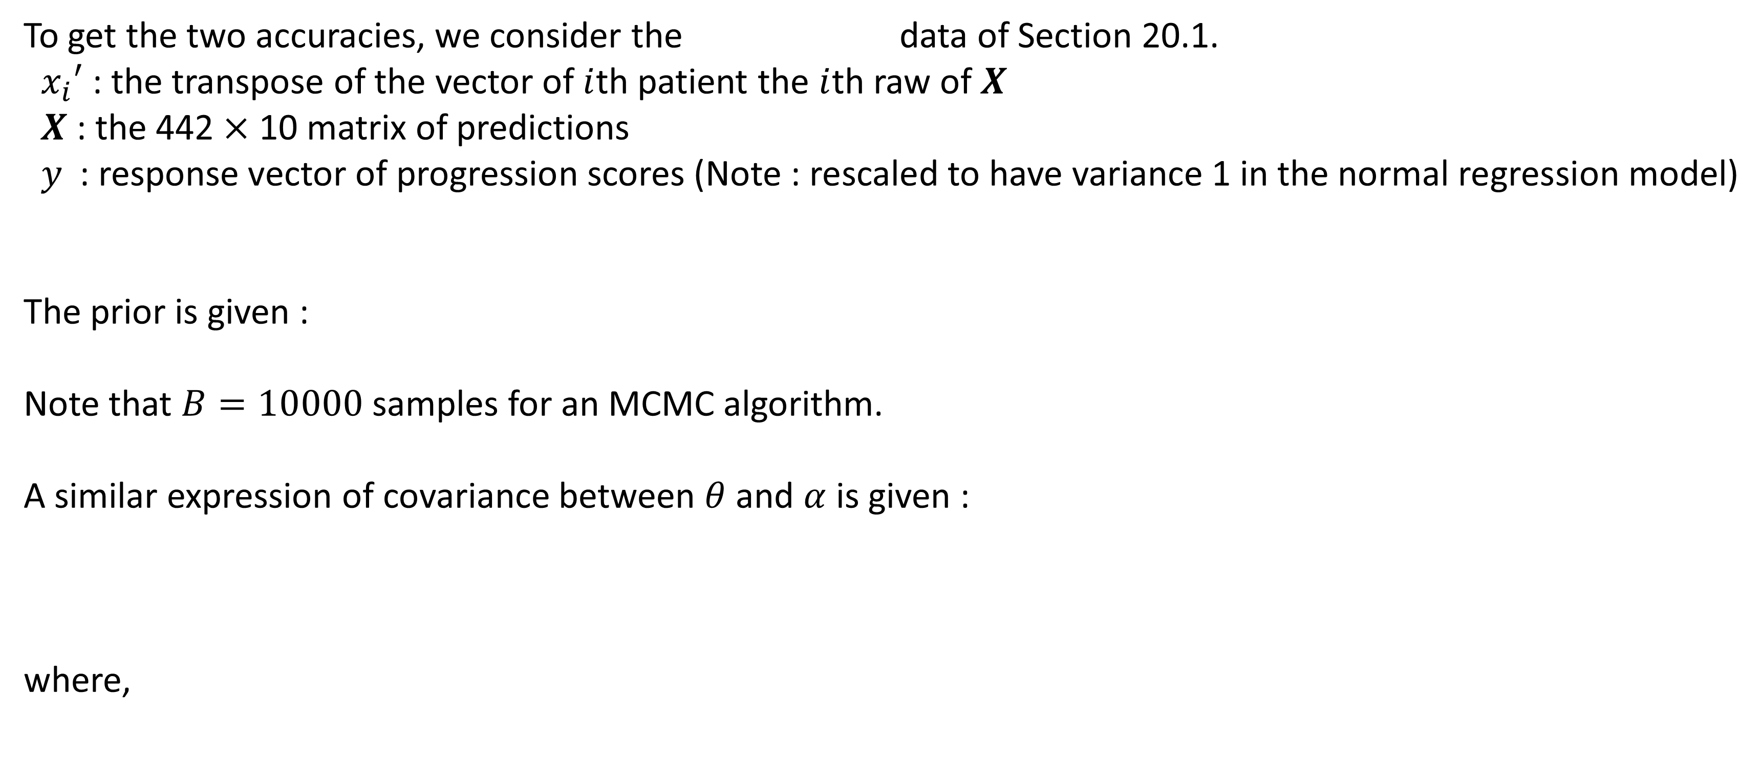
Comparison with an Example
To get the two accuracies, we consider the data of Section 20.1.
$x_{i}′$ : the transpose of the vector of $i$th patient the $i$th raw of $X$
$X$ : the 442 $×$ 10 matrix of predictions
$y$ : response vector of progression scores (Note : rescaled to have variance 1 in the normal regression model)
The prior is given :
Note that $B=10000$ samples for an MCMC algorithm.
A similar expression of covariance between $θ$ and $α$ is given :
where,

Slide 7
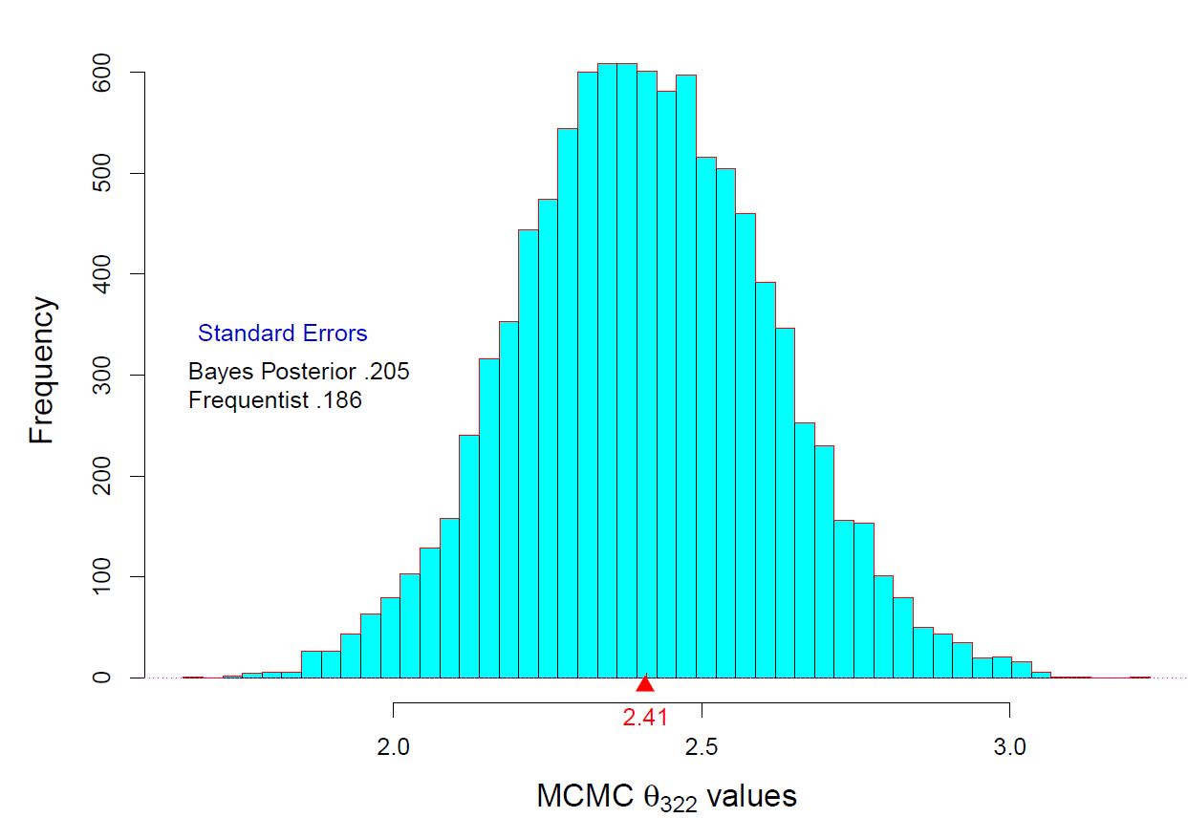
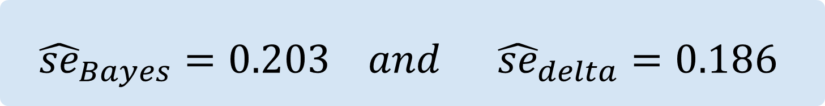
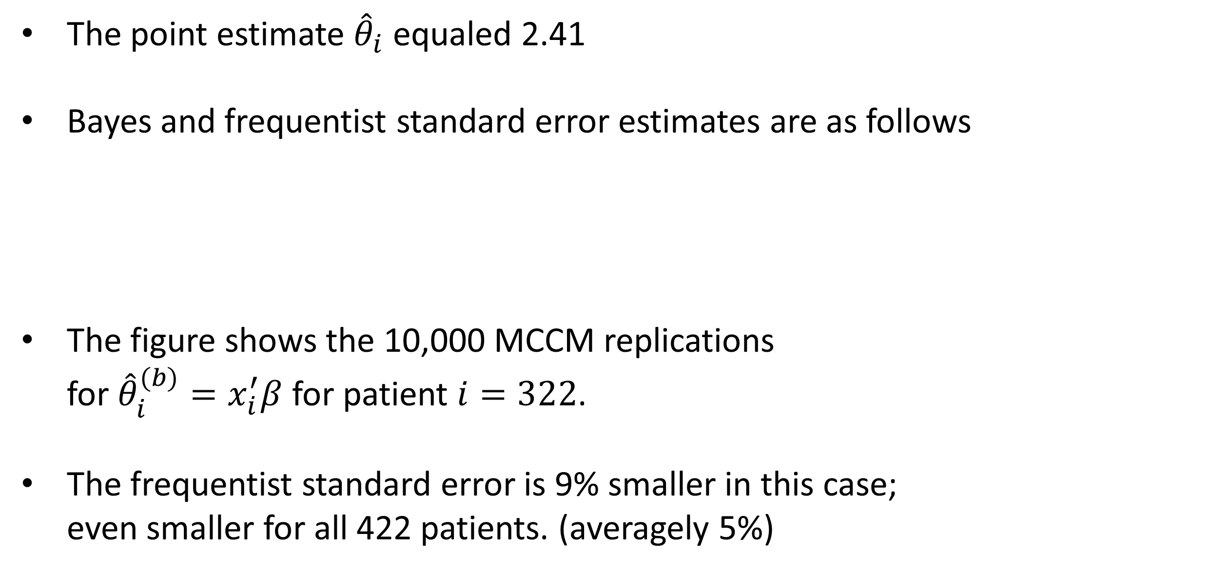
Comparison with an Example(1)
The point estimate ${\hat{θ}}_{i}$ equaled 2.41
Bayes and frequentist standard error estimates are as follows
The figure shows the 10,000 MCCM replications for ${\hat{θ}}_{i}^{(b)}=x_{i}^{′}β$ for patient $i=322$.
The frequentist standard error is 9% smaller in this case; even smaller for all 422 patients. (averagely 5%)
$${\hat{se}}_{Bayes}=0.203 and {\hat{se}}_{delta}=0.186$$

Slide 8
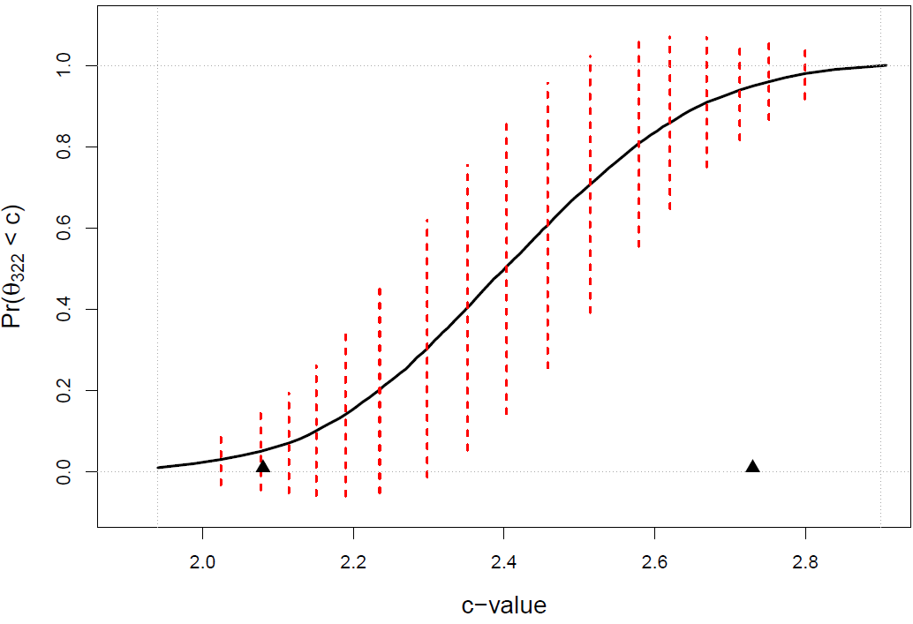
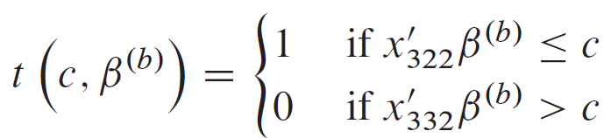
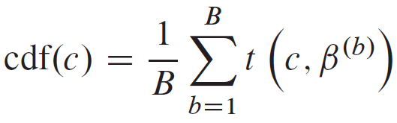
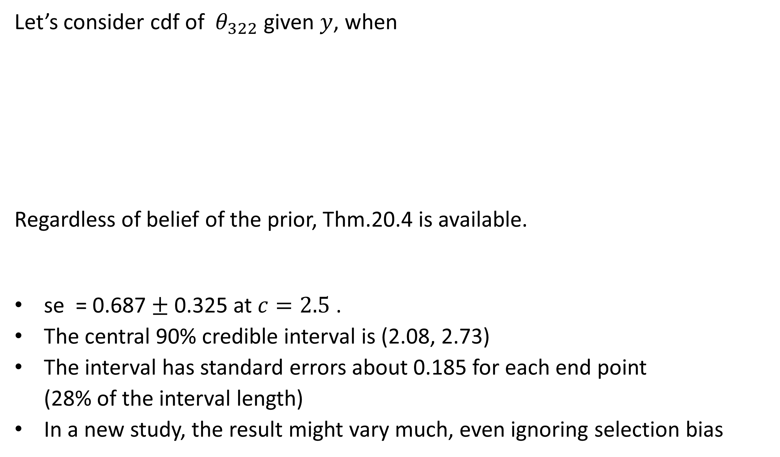
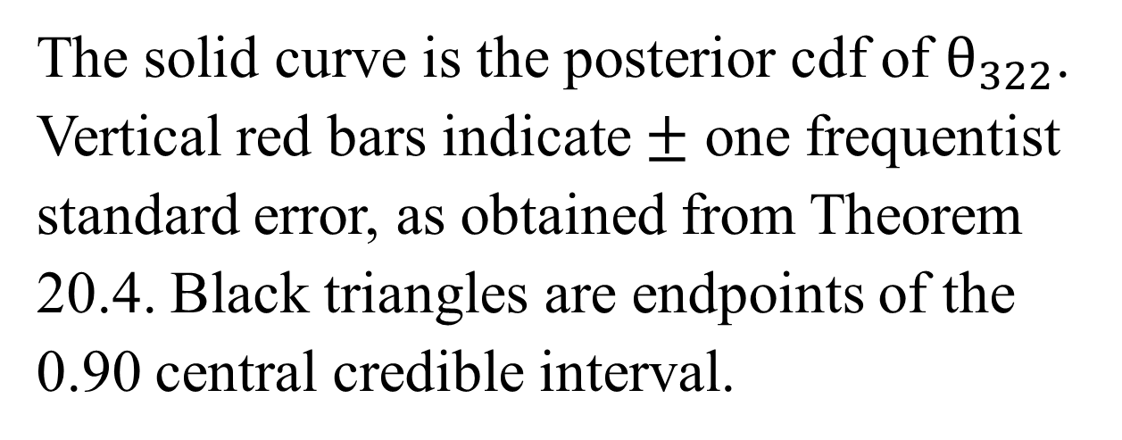
Comparison with an Example(2)
Let’s consider cdf of $θ_{322}$ given $y$, when
Regardless of belief of the prior, Thm.20.4 is available.
se = 0.687 $±$ 0.325 at $c=2.5$ .
The central 90% credible interval is (2.08, 2.73)
The interval has standard errors about 0.185 for each end point (28% of the interval length)
In a new study, the result might vary much, even ignoring selection bias
The solid curve is the posterior cdf of $θ_{322}$. Vertical red bars indicate $±$ one frequentist standard error, as obtained from Theorem 20.4. Black triangles are endpoints of the 0.90 central credible interval.

Slide 9
Conclusion
Bayesian calculations encourage a disregard for model selection effects. This can be dangerous in objective Bayes settings where one can’t rely on genuine prior experience.
Theorem 20.4 serves as a frequentist checkpoint, offering some reassurance as in the left figure, or sounding a warning as in the right figure.

Slide 10
THANK YOU
Q&A

